Slide 1

Word Generator

Slide 2
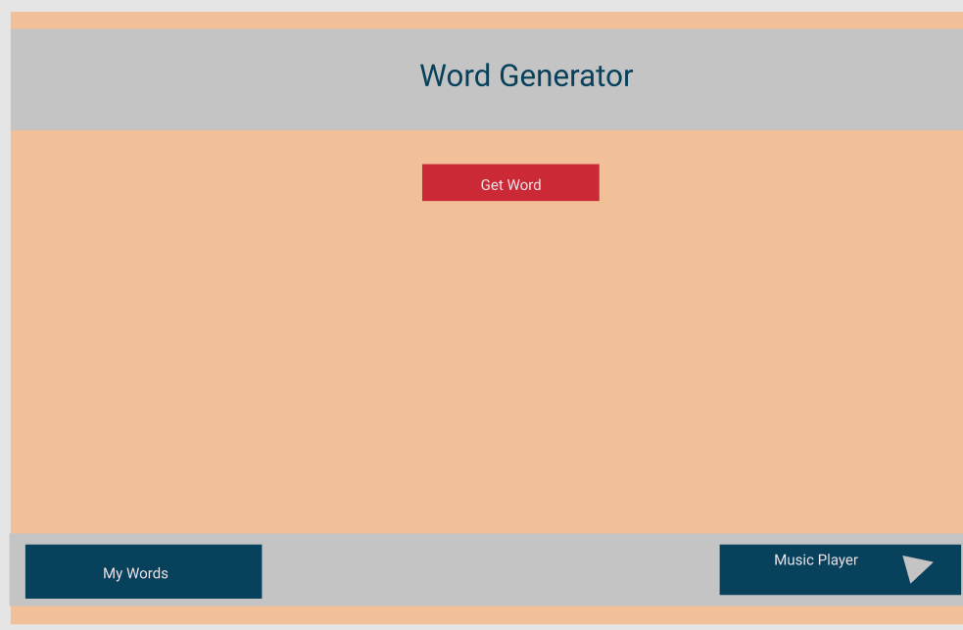

Slide 3
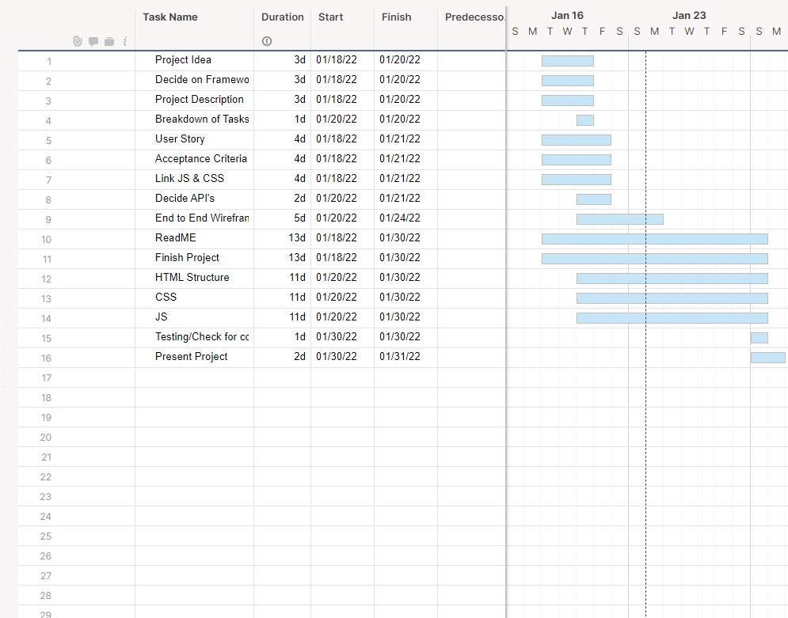

Slide 4


Slide 5


Slide 6


Slide 7
Links
https://mattdsena.github.io/GroupProject/
https://github.com/Mattdsena/GroupProject

